Slide 1
Implementation of Decision Tree Regression using ID3 algorithm from scratch using Python
~ Suhas D S

Slide 2
Outline:
5. Model building from Scratch
* Split dataset into train and test set
* Define and fit the model
* Model summary
* Summary statistics
* Model adequacy checking
6. Conclusion
1. Explore dataset
* Missing or null values
* Distributions
* Summary statistics
2. Multi-collinearity
* Correlation matrix
3. Categorical variable
4. Outlier analysis

Slide 3
Problem Statement
Determine the Fish weight dataset and developing a Decision tree regression model to predict the Fish weight based on length and height .

Slide 4
Features of the Dataset
Rows:
* We have 159 rows in our dataset
Features:
* We have 7 columns in that
- 6 numerical features
- 1 categorical features
Target Variable: weight
Problem Type- Regression type

Slide 5
Data Cleaning and Pre-processing
Column descriptions
Weight - weight of fish in grams Length1 - vertical length in cm Length2 - Diagonal length in cm Length3 - Cross length in cm Height - height in cm Width - Diagonal width in cm

Slide 6

Rename the columns:
Here I used .rename to change some column names such as:
1. Length1':'Vertical_Length‘
2. Length2':'Diagonal_Length
3.Length3':'Cross_Length'

Slide 7
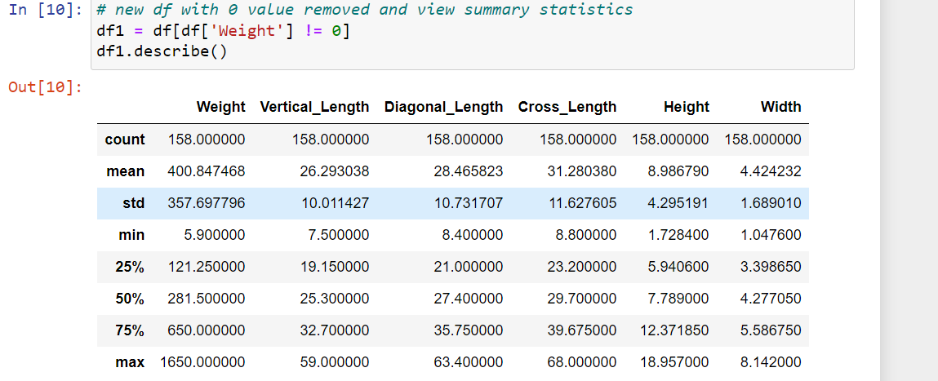
Data.describe() it gives us summary statistics for numerical columns in our dataframe

Slide 8
Here without using sklearn I converted categorical variables to numerical by using .replace ()
Perch - 0
Bream- 1
Roach- 2
Pike- 3
Smelt- 4
Parkki - 5
Whitefish- 6

Slide 9
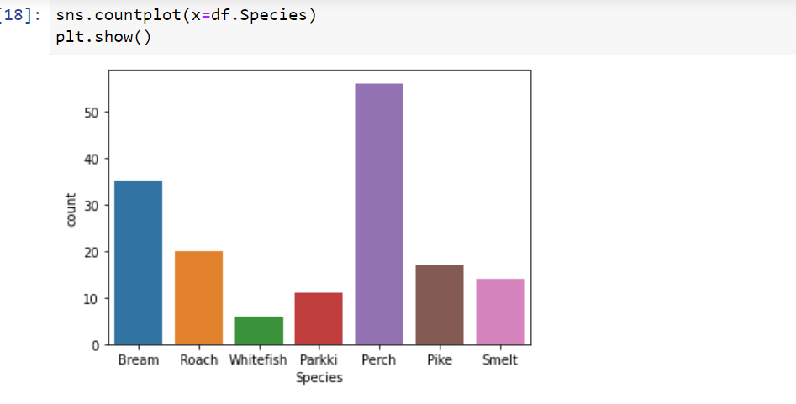
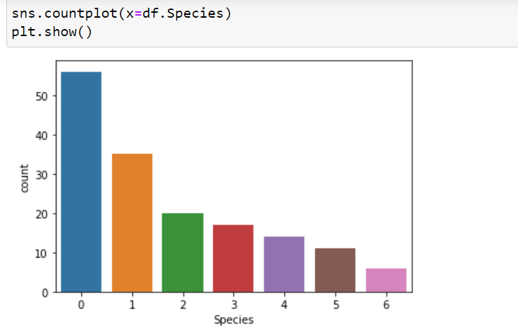

Slide 10
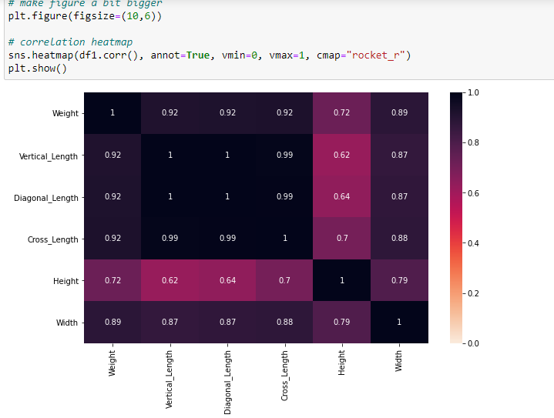
Correlation graph is very useful to highlight the most correlated variables in a data table

Slide 11
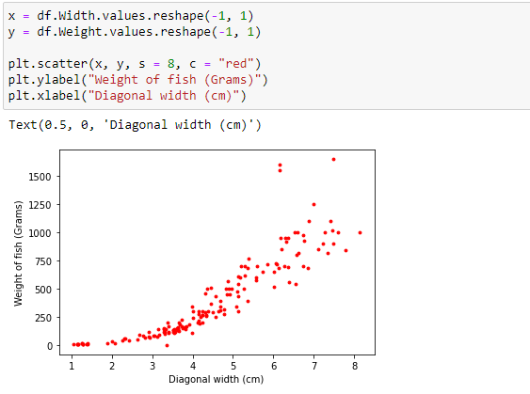
Here I used scatter plot , in this we can see that when width is increasing even the weight of the fish is also increasing

Slide 12
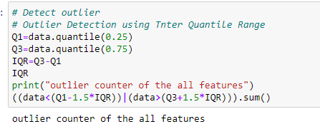
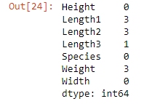
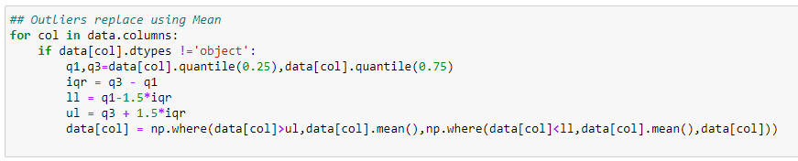
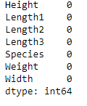
Here I replaced the outliers by using mean()
So after replacing we can see no outliers

Slide 13
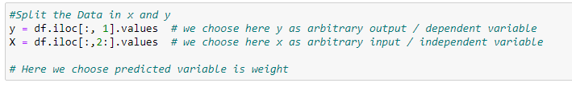
Here I choose weight as my target column and gave Y as arbitrary output.
And by leaving Species and weight columns , I took remaining columns as my independent variables and gave X as arbitrary input.

Slide 14
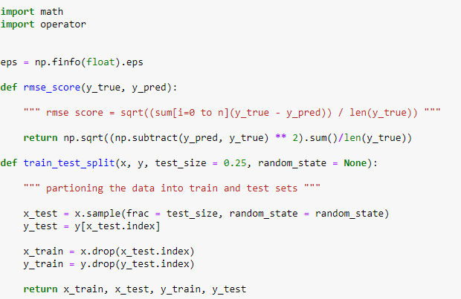
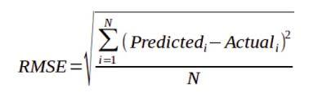
Model building by Scratch
Here I defined rmse score for evaluating the quality of predictions
To predict we need train and test data both so to split the data here I defined train_test_split without using SKLEARN

Slide 15
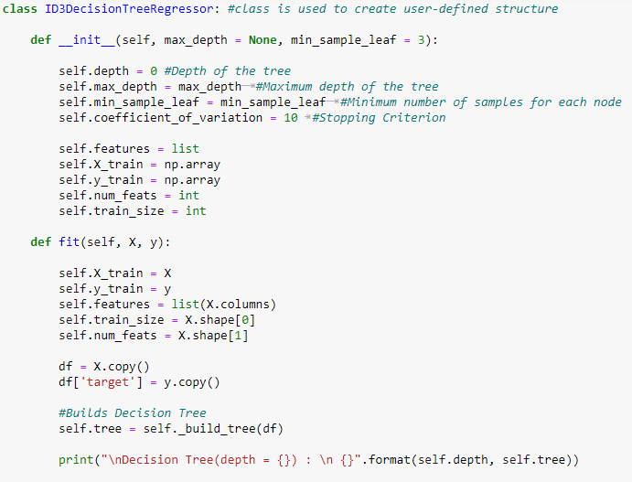
Here I created the user-defined structure and named it as ID3DecisionTreeRegression.
Here __init__() is a constructor used to initialize the data members of the class when a class is initiated
Self is used to represent the instance of the class , by using this we can access the attribute and methods of the class in python .
def keyword is used to define a function .

Slide 16
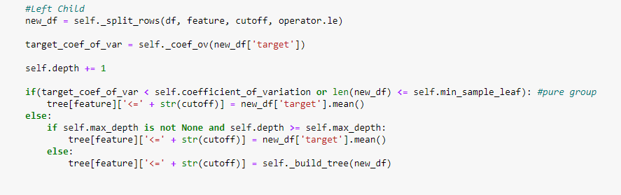
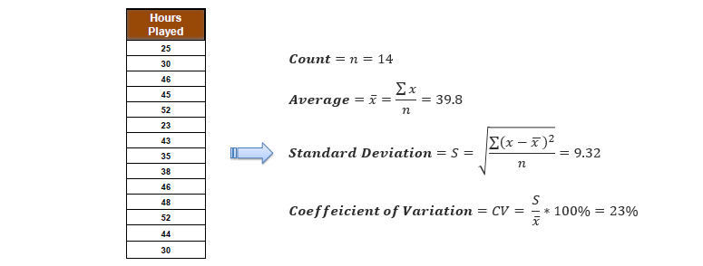
operator.le - this method is used to compare each value in a dataframe to check if it is less than, or equal to a specified value and returns the dataframe with boolean true/ false for each comparision.
The coefficient of variation (CV) is defined as the ratio of the standard deviation to the mean, And used to decide when to stop branching.

Slide 17
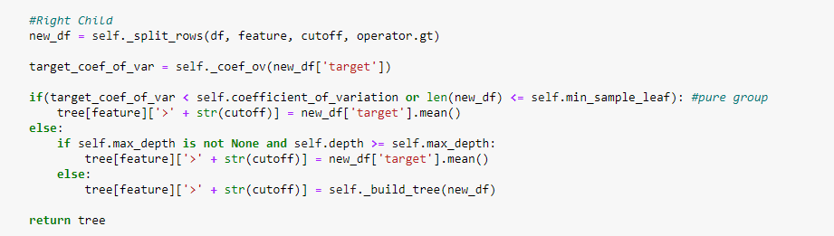
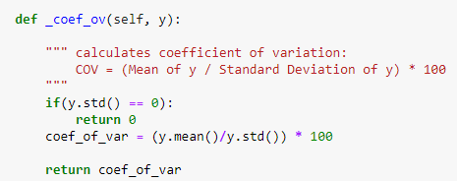
operator.gt – It compares each value in a dataframe to check if it is greater than specified value and returns a dataframe with boolean True/False for each comparision.

Slide 18
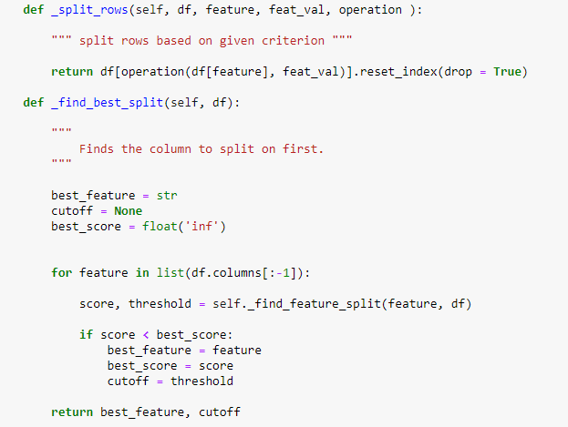
The standard deviation reduction is based on the decrease in standard deviation after a dataset is split on an attribute.
Constructing a decision tree is all about finding attribute that returns the highest standard deviation reduction (i.e., the most homogeneous branches).

Slide 19
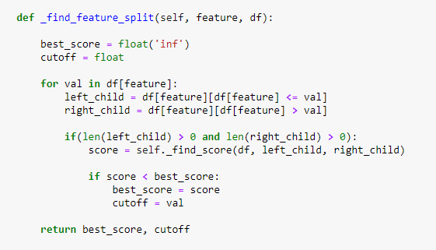
The dataset is divided based on the values of the selected attribute. This process is run recursively on the non-leaf branches, until all data is processed.

Slide 20
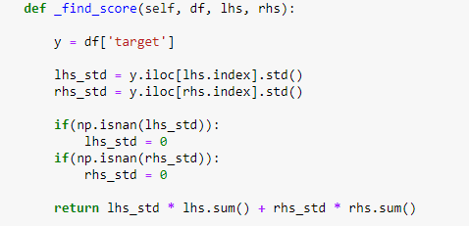
LHS – left hand side.
RHS – right hand side.
.std()-used to compute the standard deviation along the specified axis

Slide 21
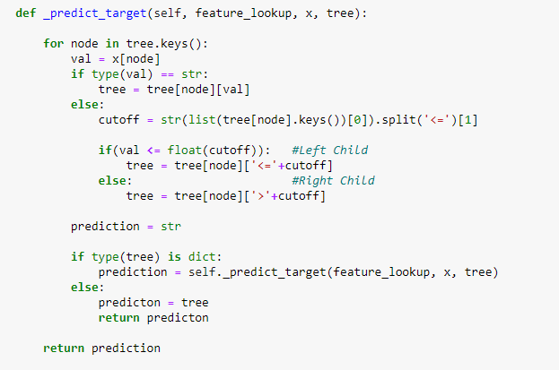
Here this code is for predicting the target variable and give the prediction

Slide 22
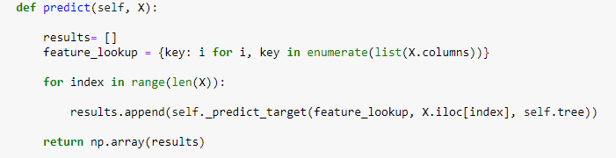
By this our ID3DecisionTreeRegression model is build and it is ready for
Fitting the data for prediction

Slide 23
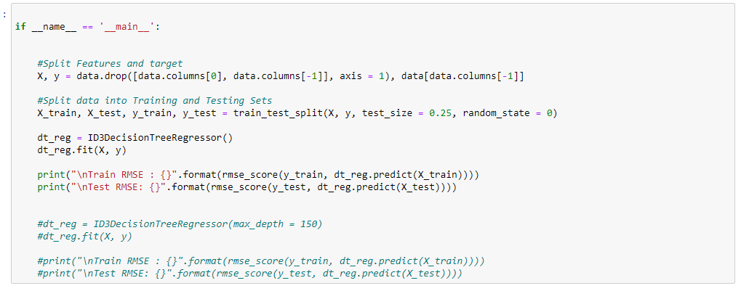
In this step we will be splitting our dataset into train and test data with test size of 25%
And we fit X and Y to our model and it will give the output
And even it will show the rmse value by evaluating the quality of the prediction

Slide 24

This is the RMSE value for both train and test
For train- 0.192
For test – 0.195
Hence our model predicts with less error and gives output we successfully
Made code from scratch for Decision Tree regression for ID3 algorithm .

Slide 25
- THANKING YOU

